Slide 1
Capstone Project-3
Health Insurance Cross-Sell Prediction
Kunal Agrawal

Slide 2
Predicting Health Insurance Cross-Sell
Defining Problem Statement
EDA and Feature Engineering
Feature Selection
Preparing Dataset for Modelling
Applying Model
Conclusion

Slide 3
Problem Statement
Cross-Selling Motor Insurance
Existing Health Insurance
Predict intention to buy Motor Insurance
Effective Targeting Strategy
Optimizing Business Model and Revenue
Implementing predictive modelling

Slide 4
Approach
Data Preprocessing:
Loading Dataset
Removing Duplicate Value
EDA
Univariate Analysis
Outlier Treatment
Discretization : Age and Annual Premium
Encoding Categorical variables
Mean Encoding: Responses on Policy Sales Channel
Feature Selection
Plotting Correlation Matrix
Normalizing and Scaling
Chi-square Test

Slide 5
Approach Contd.
Handling Class Imbalance
SMOTE
Model Creation
Logistic Regression Model
Decision Tree
Random Forest
Light GBM
XGBM
Stacking
Hyper-parameter Tuning
Conclusion

Slide 6
Data Summary I
Variable | Format | Description
ID | Numeric | a unique Id for each policy_holder
Gender | Categorical | Gender of Customer
Age | Numeric | Age of the customer
Driving_License | Categorical | an indicator for whether the policyholder has Driving License 0 = No License, 1 = Possess License
Region_Code | Numerical | Unique code for the region of the customer
Previously_Insured | Categorical | 1 : Customer already has Vehicle Insurance, 0 : Customer doesn't have Vehicle Insurance

Slide 7
Data Summary II
Variable | Format | Description
Vehicle_Age | Numerical | Age of the Vehicle
Vehicle_Damage | Categorical | 1 : Customer got his/her vehicle damaged in the past. 0 : Customer didn't get his/her vehicle damaged in the past
Annual_Premium | Numeric | The amount customer needs to pay as premium in the year
PolicySalesChannel | Categorical | Anonymized Code for the channel of outreaching to the customer ie. Different Agents, Over Mail, Over Phone, In Person, etc.

Slide 8
Data Summary III
Variable | Format | Description
Vintage | Numeric | Number of Days, Customer has been associated with the company
Response | Categorical: Dependent Variable | 1 : Customer is interested, 0 : Customer is not interested

Slide 9
Basic EDA
Duplicate Values Check
269 Duplicate Values observed
Duplicate Values were removed
Null Values Check
No Null Values observed
Univariate Analysis
Bivariate Analysis

Slide 10
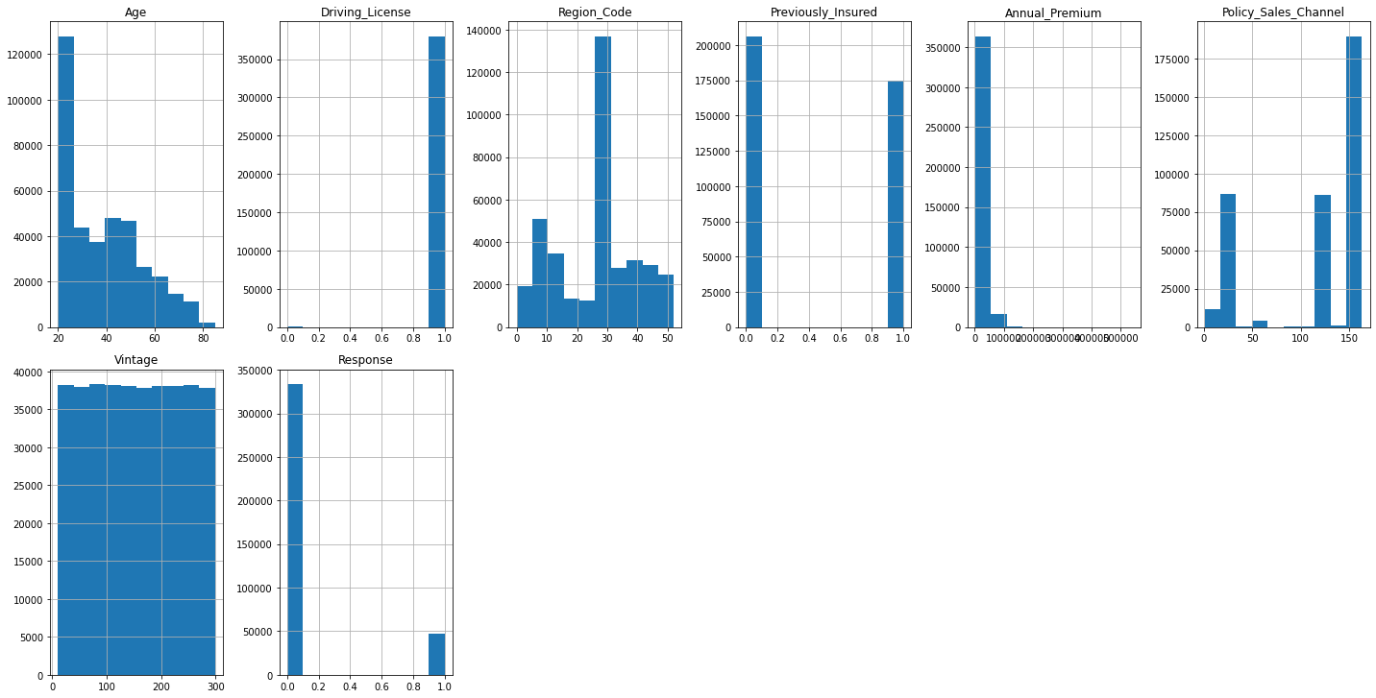
Univariate Analysis

Slide 11
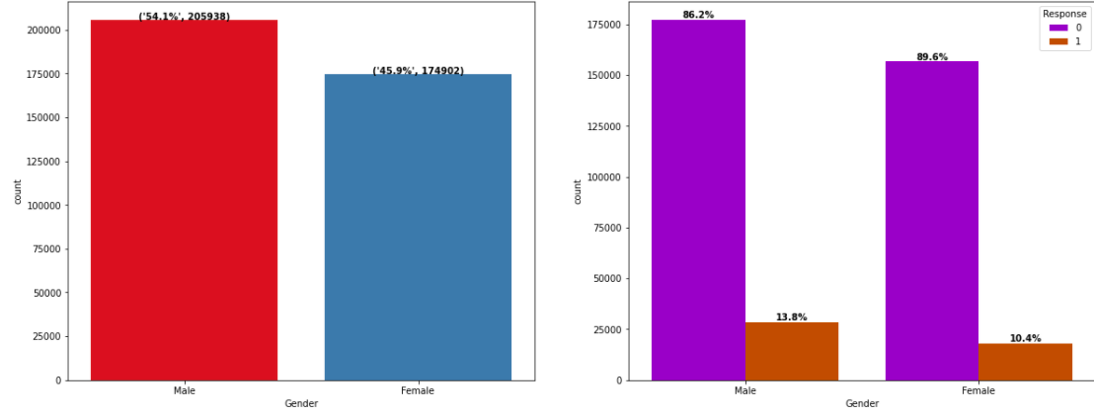
EDA
Gender Distribution and Reponse

Slide 12
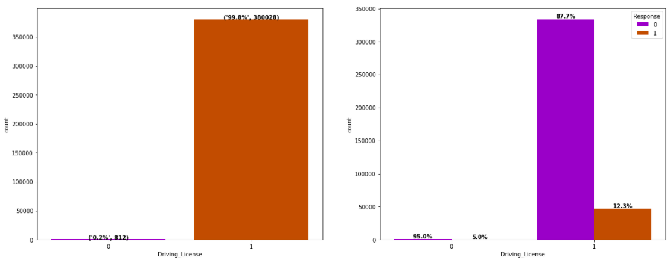
EDA
Driving license Distribution and Response Rate

Slide 13
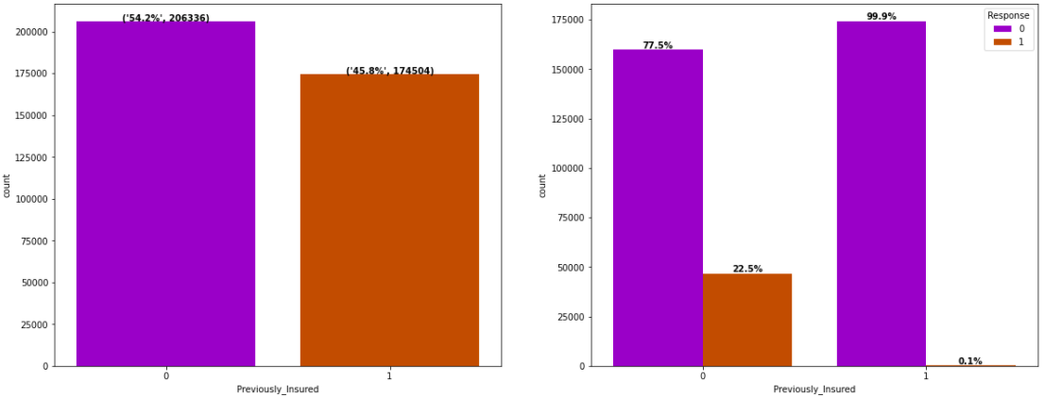
EDA
Previously Insured and Response Rate

Slide 14
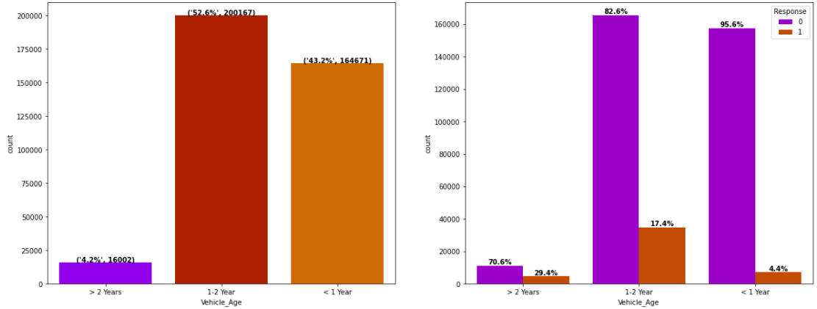
EDA
Vehicle Age and Response Rate

Slide 15
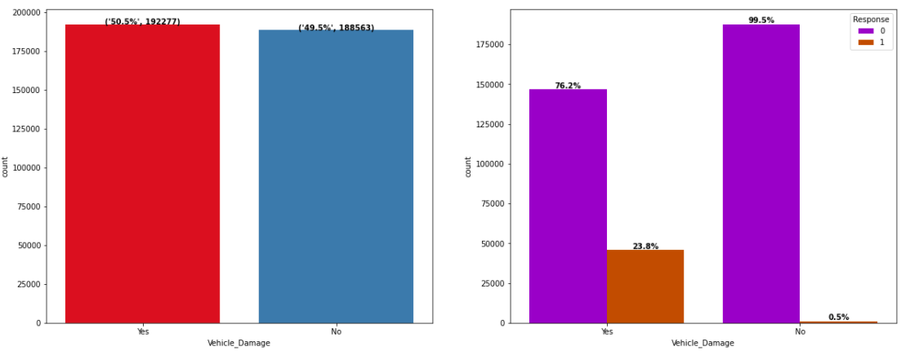
EDA
Vehicle Damage and Response Rate

Slide 16
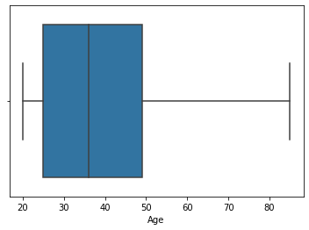
EDA
Box-Plot: Age

Slide 17
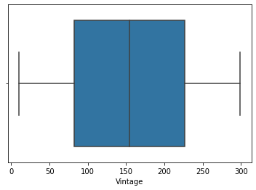
EDA
Box-Plot: Vintage

Slide 18
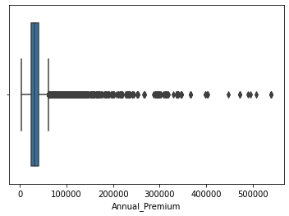
EDA
Box-Plot Annual Premium: Before Treatment

Slide 19
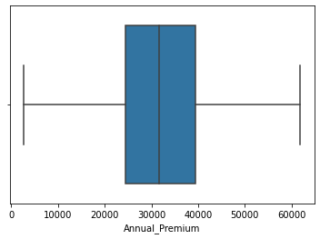
EDA
Box-Plot Annual Premium
Outlier Treatment: Limiting Outliers to upper ceiling

Slide 20
Conclusions- EDA
Male are norrowly more interested in taking can insurance: 13.4% vs 10.8%
People with Driving license would be more interested in taking Motor Insurance
As expected, people who don't have motor insurance are more interested in taking motor insurance
More number of vehicles have age less than 2 years
People with motor having age between 1 to 2 year are more interested in taking Motor Insurance
Customers having their Vehicle damaged are more susceptible to take motor insurance

Slide 21
Features Engineering
Data Cleaning
Gender and Vehicle Damage Column: Converting Yes and No into 0 and 1
Dropping Driving License Column
One-Hot Encoding
Vehicle Age
Discretization of Data
Age
Annual Premium
Mean Encoding
Policy Channel
Scaling
Vintage Column

Slide 22
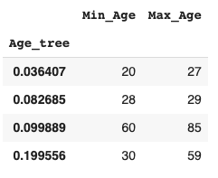
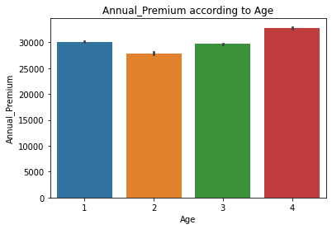
Discretization: Age Column
Creation of four bins

Slide 23
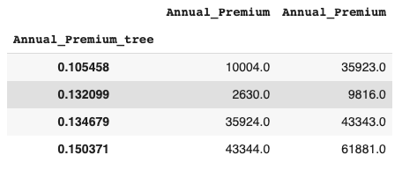
Discretization: Annual Premium Column
Creation of four bins

Slide 24
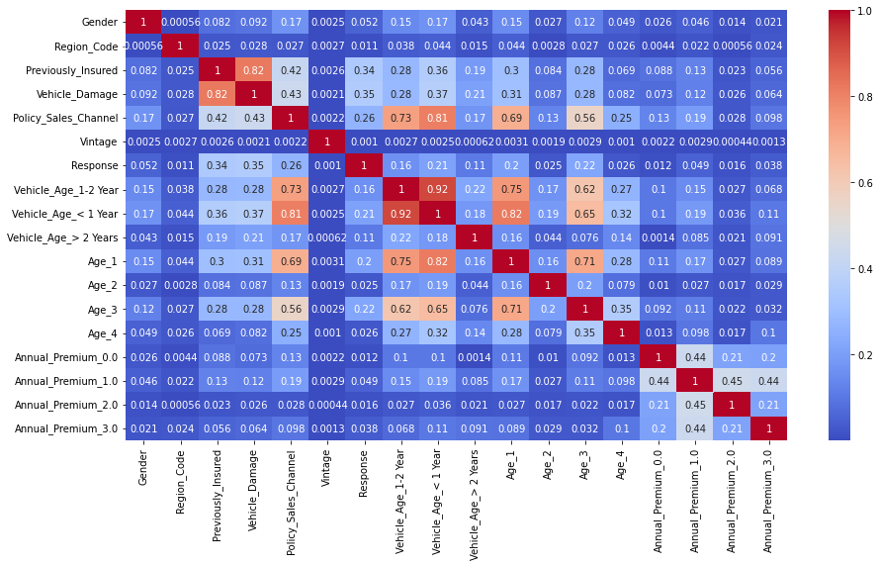
Correlation Matrix

Slide 25
Models Implemented
Logistic Regression
Decision Tree
Random Forest
Light GBM
Naive Bayes
XG Boost
Stacking
Logistic Regression
Random Forest
Light GBM
XGBoost

Slide 26
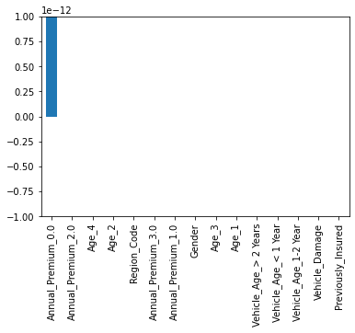
Chi-Square Test

Slide 27
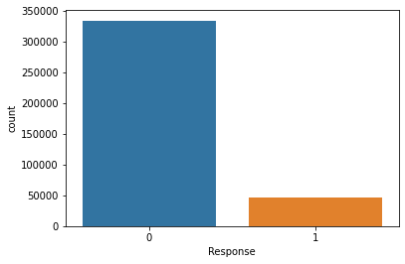
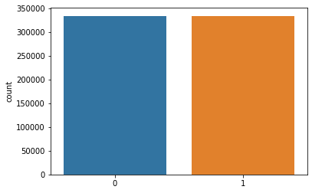
Handling Class Imbalance
SMOTE Technique Employed
Original dataset shape: 380840
Resampled dataset shape: 668310

Slide 28
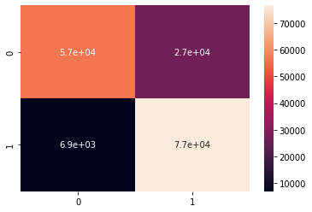
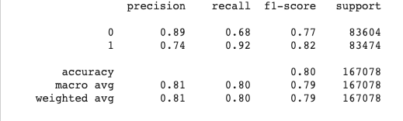
Logistic Regression
y
ROC AUC Score Train: 0.7963
ROC AUC Score Test: 0.7974

Slide 29
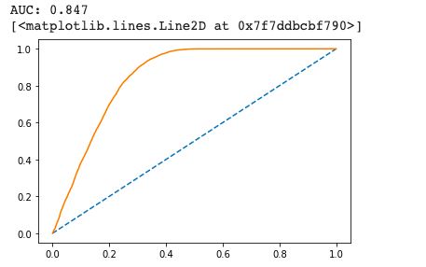
Logistic Regression: ROC-AUC Curve

Slide 30
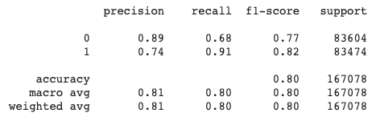
Logistic Regression: Hyper-Parameter Tuning

Slide 31
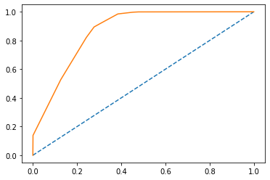
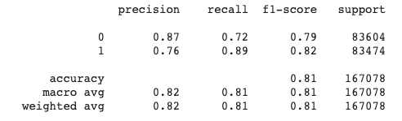
Decision Tree
Basic Decision Tree
ROC-AUC Score Train Set: 0.8083
ROC-AUC Score Test Set: 0.8087
√

Slide 32
Decision Tree
Hyper-parameter tuning
ROC-AUC Score Train Set: 0.9706
ROC-AUC Score Test Set: 0.8627
Overfitting Observed

Slide 33
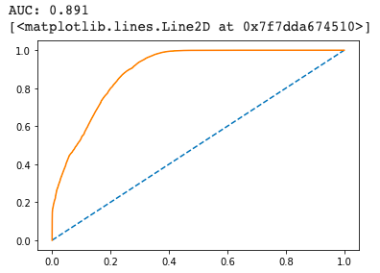
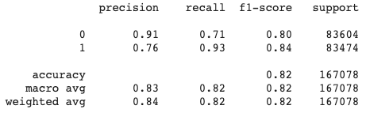
Random Forest
Best Parameters: {'max_depth': 10, 'n_estimators': 50}
ROC-AUC Score Train Set: 0.8191
ROC-AUC Score Test Set: 0.8190
Neither over-fit nor under-fit

Slide 34
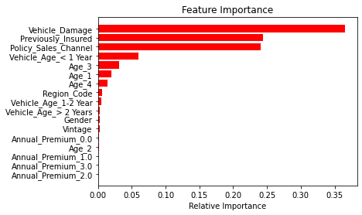
Variable Importance: Random Forest

Slide 35
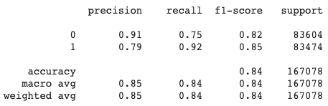
Light GBM
Best Parameters: {'bagging_fraction': 0.5, 'max_bin': 600, 'max_depth': 10}
ROC-AUC Score Train Set: 0.8385
ROC-AUC Score Test Set: 0.8382
Neither over-fit nor under-fit

Slide 36
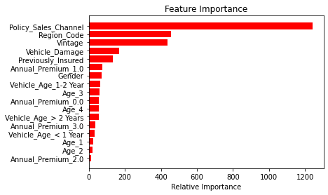
Variable Importance: LGBM

Slide 37
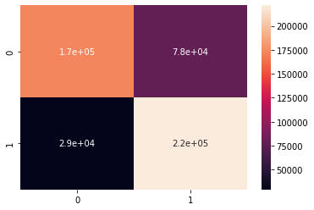
Naive Bayes
Best Estimator: GaussianNB(priors=None, var_smoothing=0.000657933224)
ROC-AUC Score Train Set: 0.7863
ROC-AUC Score Test Set: 0.7872
Neither over-fit nor under-fit

Slide 38
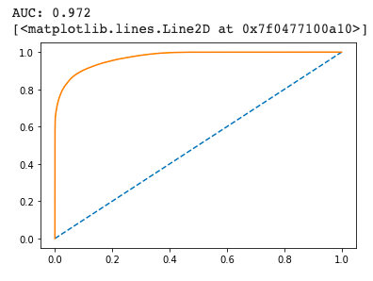
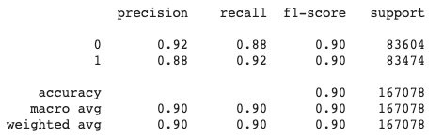
Xtreme GBM
Best Parameter: {learning_rate=0.1, max_depth=3, n_estimators=100}
ROC-AUC Score Train Set: 0.9145
ROC-AUC Score Test Set: 0.8974
Neither over-fit nor under-fit

Slide 39
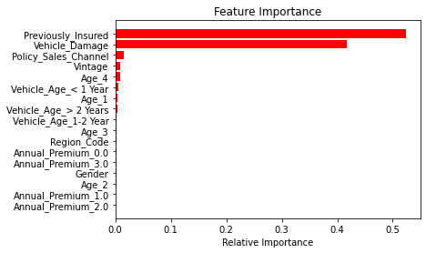
Feature Importance Xtreme GBM

Slide 40
Stacking
Level0:
Logistic Regression
Random Forest
Light GBM
Level 1
Xtreme GBM

Slide 41
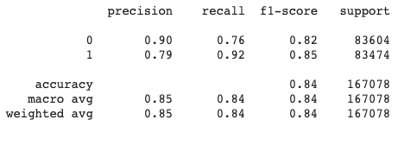
Stacking
Scores
Accuracy Score Test Set: 0.8390
Accuracy Score Train Set: 0.8389
Neither over-fit nor under-fit

Slide 42
Model Scores I
Model | Train AUC-ROC Score | Test AUC-ROC SCore | Recall TEST for Class 1
Logistic Regression | 0.7963 | 0.7974 | 0.92
Logistic Regression (Hyperparameter tuned) | 0.7973 | 0.7983 | 0.92
Decision Tree | 0.8083 | 0.8087 | 0.89
Decision Tree (Hyperparameter Tuned) | 0.9703 | 0.8630 | 0.86
Random Forest | 0.8191 | 0.8190 | 0.93

Slide 43
Model Scores II
Model | Train AUC-ROC Score | Test AUC-ROC SCore | Recall TEST for Class 1
Light GBM | 0.8385 | 0.8382 | 0.92
Naive Bayes | 0.7973 | 0.7983 | 0.88
XGBM | 0.9144 | 0.8985 | 0.92
Stacking | 0.8385 | 0.8391 | 0.92

Slide 44
Conclusions
No underfitting or overfitting observed
AUC-ROC Score of XGBM is around 89%
Stacking prediction was on lower side in comparison to XGBM
XGBM can be employed for prediction purposes

Slide 45
Challenges
Imbalance in Dataset
Computation Time
Huge Dataset after balancing data

Slide 46
Questions?

